Slide 1
ART User Guide

Slide 2

What is ART?
The Accessibility Requirements Tool (ART) is a self-service job aid.
ART’s primary purpose is to assist project teams with:
Identifying what specific 508 standards apply to project deliverables to support project planning.
Obtaining tailored accessibility related question in Requests for Information (RFIs) to support market research.
Obtaining accurate Section 508 requirements to include in solicitations that include technology deliverables.

Slide 3





Who should use ART?
Procurement Officials
Project Managers
Design Teams
Developers
Testers

Slide 4
When should ART be used?
Whenever you are buying or building information and communications technology (ICT), including:
Electronic content
Software
Hardware
Cloud services
Service to buy, build, modify, configure, install, implement, maintain and support ICT

Slide 5
How does ART work?
1. ART will ask you a few simple questions about what IT products and services you are buying or building.
2. As you answer each question, one or more follow-up questions may appear based on your response. Please answer the follow-up questions before proceeding to the next section.
3. Based on your answers, ART will use an internal algorithm to determine which Section 508 standards and requirements apply to your IT products and services
4. ART will produce language to communicate the applicable Section 508 standards and requirements.

Slide 6
Are the ART questions hard to answer?
If you have a basic understanding of what you are buying or building, you should be able to answer the ART questions in 5-10 minutes in most cases and 10-15 minutes for multiple components.
No personal knowledge of Section 508 or accessibility is required to use ART!

Slide 7
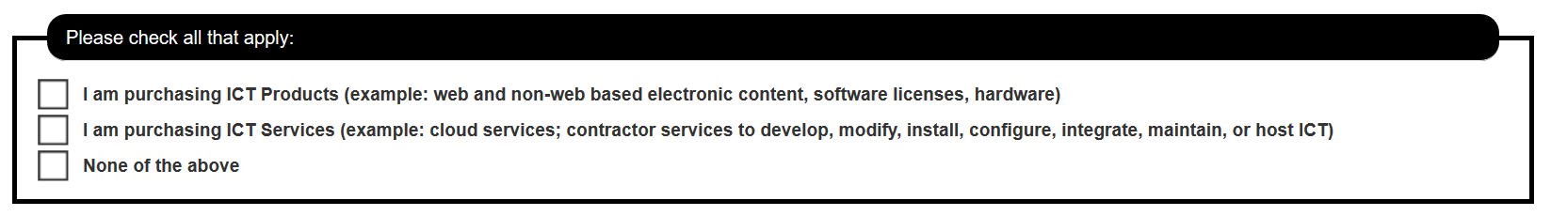
Example Questions

Slide 8
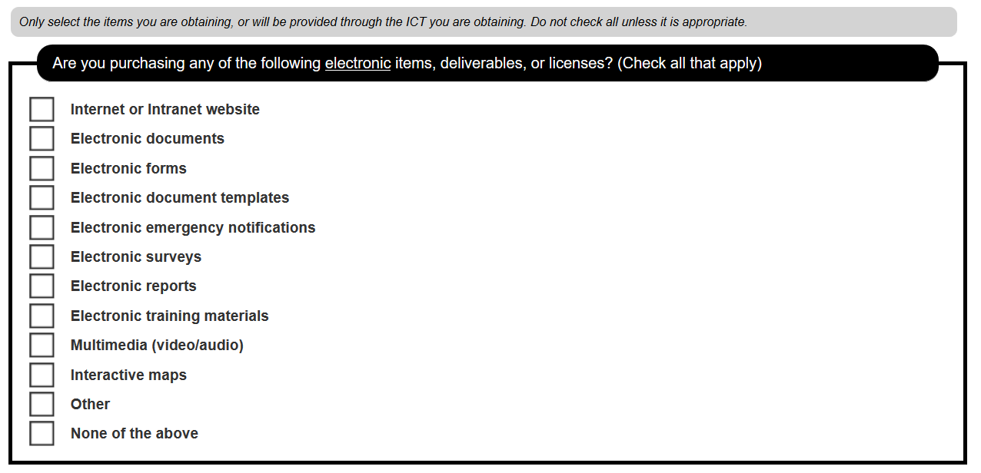
Example Questions

Slide 9
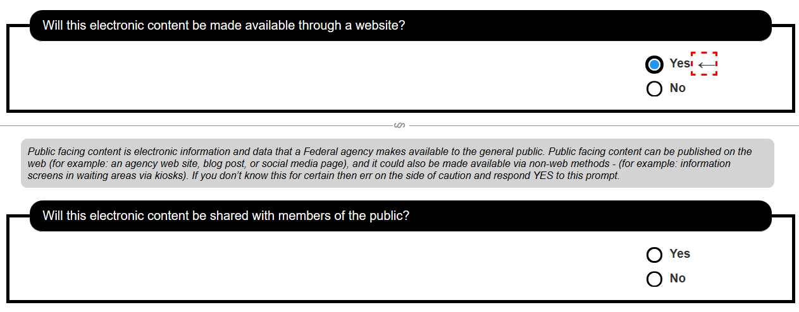
Example Questions

Slide 10
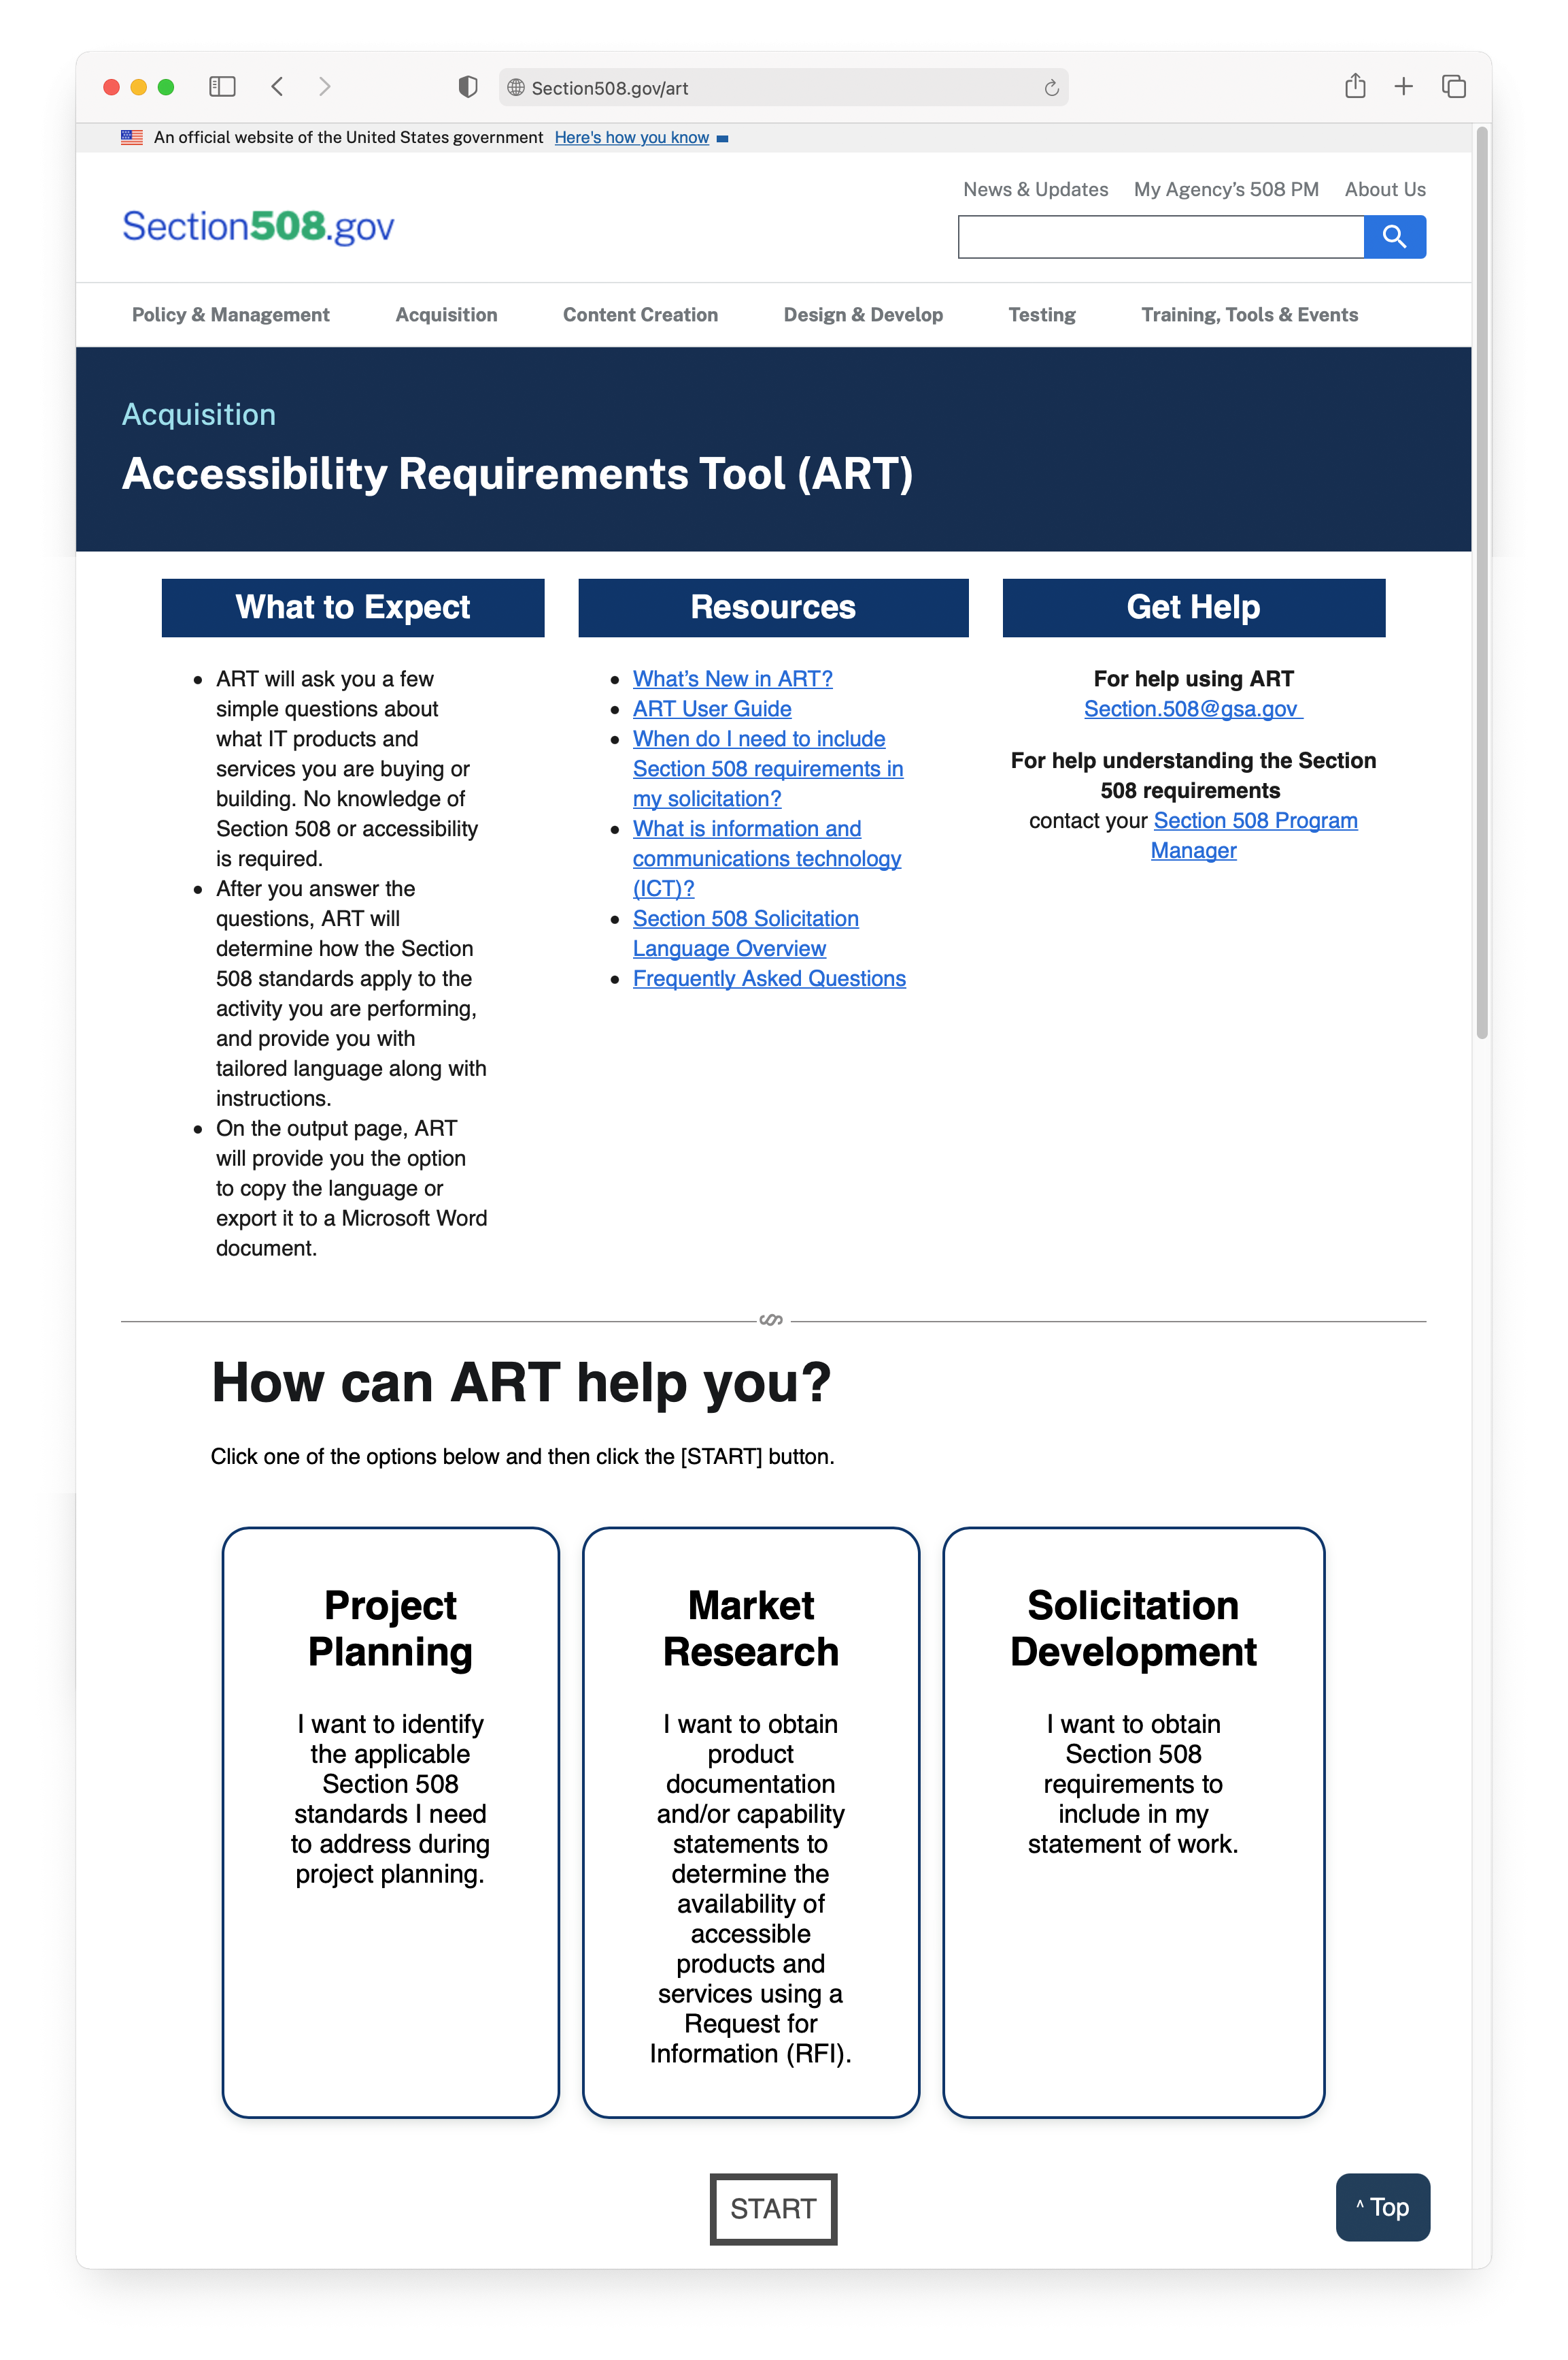
Getting oriented to the Home Page
Use your mouse to select the task you want ART to assist you with:
Project Planning,
Market Research, or
Solicitation Development
And select the start button.

Slide 11
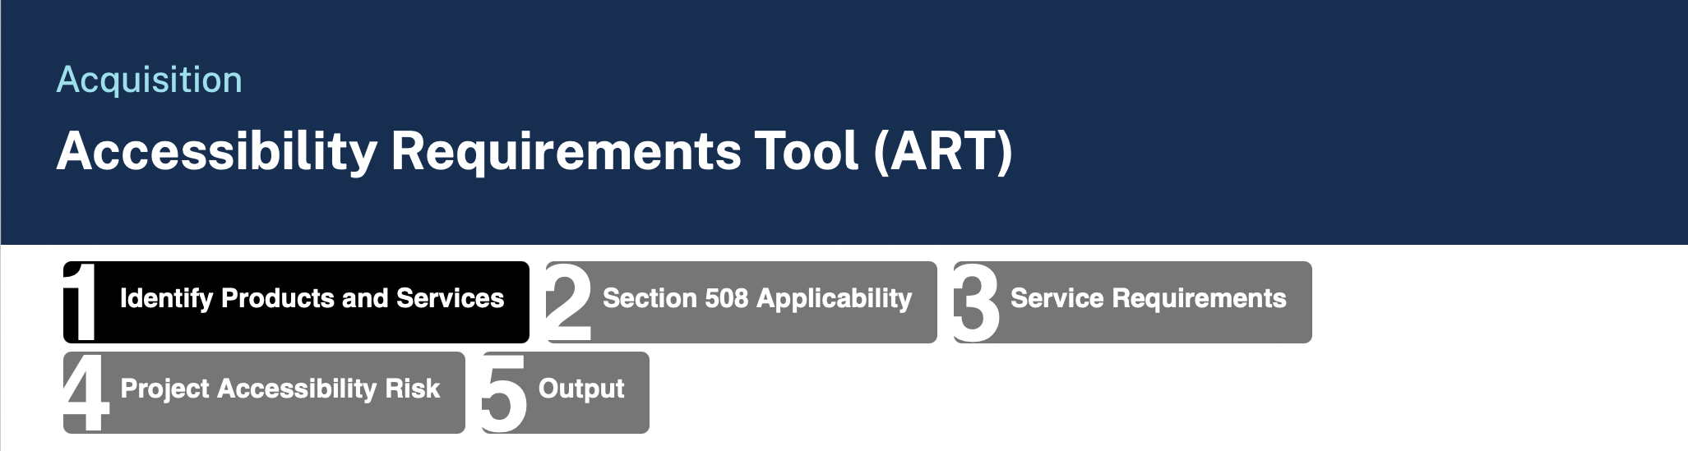
Getting oriented to the Main Menu
ART gathers information in a five step process. Look to the menu on the top of the screen to see where you are in the process
The entire process should take 5 minutes to complete for most projects.

Slide 12
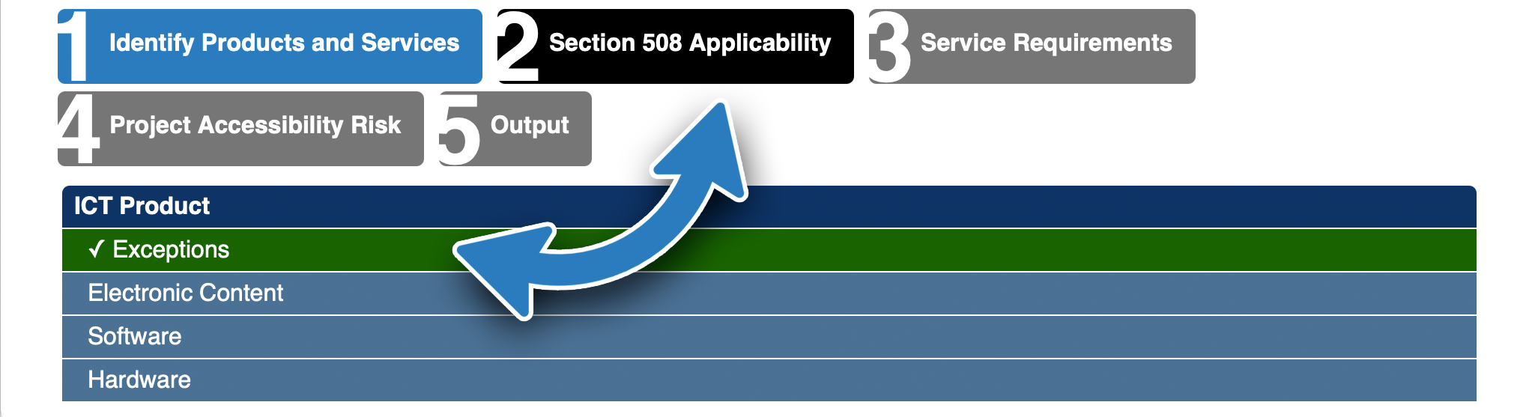
Getting oriented to the Sub-Menu
ART provides a sub-menu when you are in Step 2.
This menu helps you navigate between the four different areas in this section.
Exceptions
Electronic Content
Software
Hardware

Slide 13
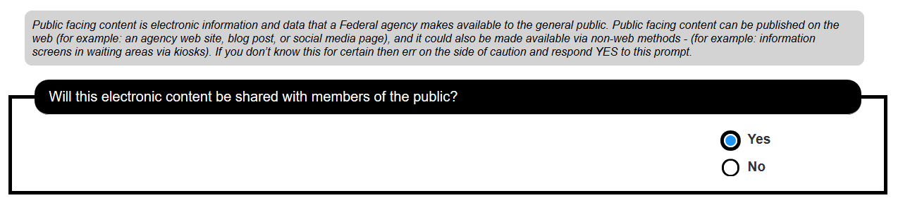
Getting oriented to the instructions
For some questions, ART provides extra guidance in the gray area above the question. Read this guidance to make sure you fully understand the question.

Slide 14
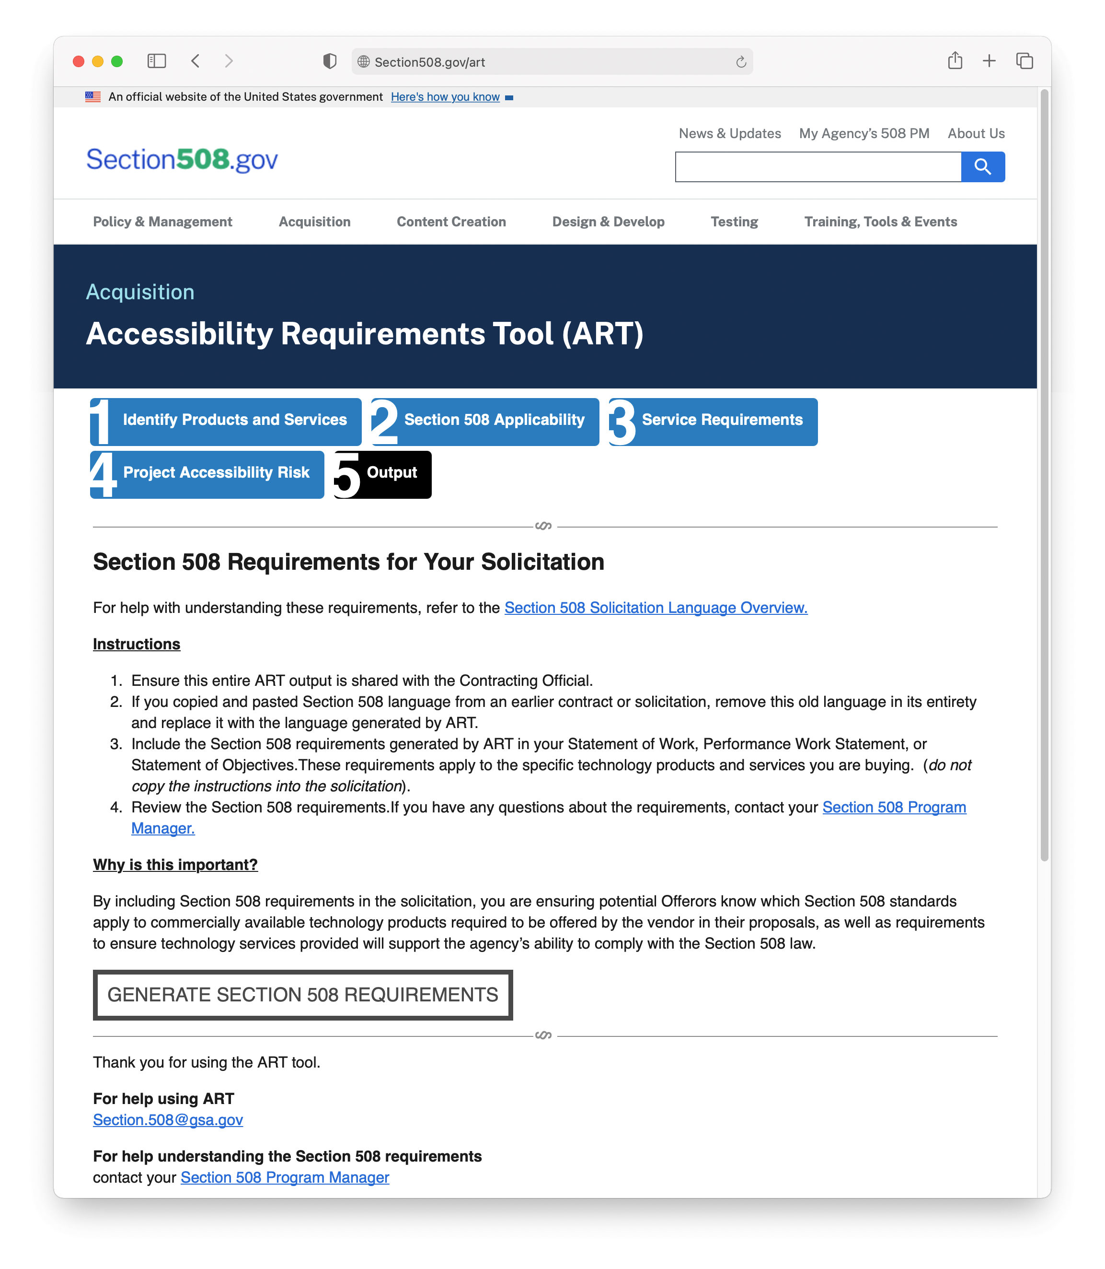
Getting oriented to the Output Generation Screen
Once you have answered all the ART questions – you will be taken to the output screen.
Please read the on-screen instructions carefully – and then select the “Generate” button.

Slide 15
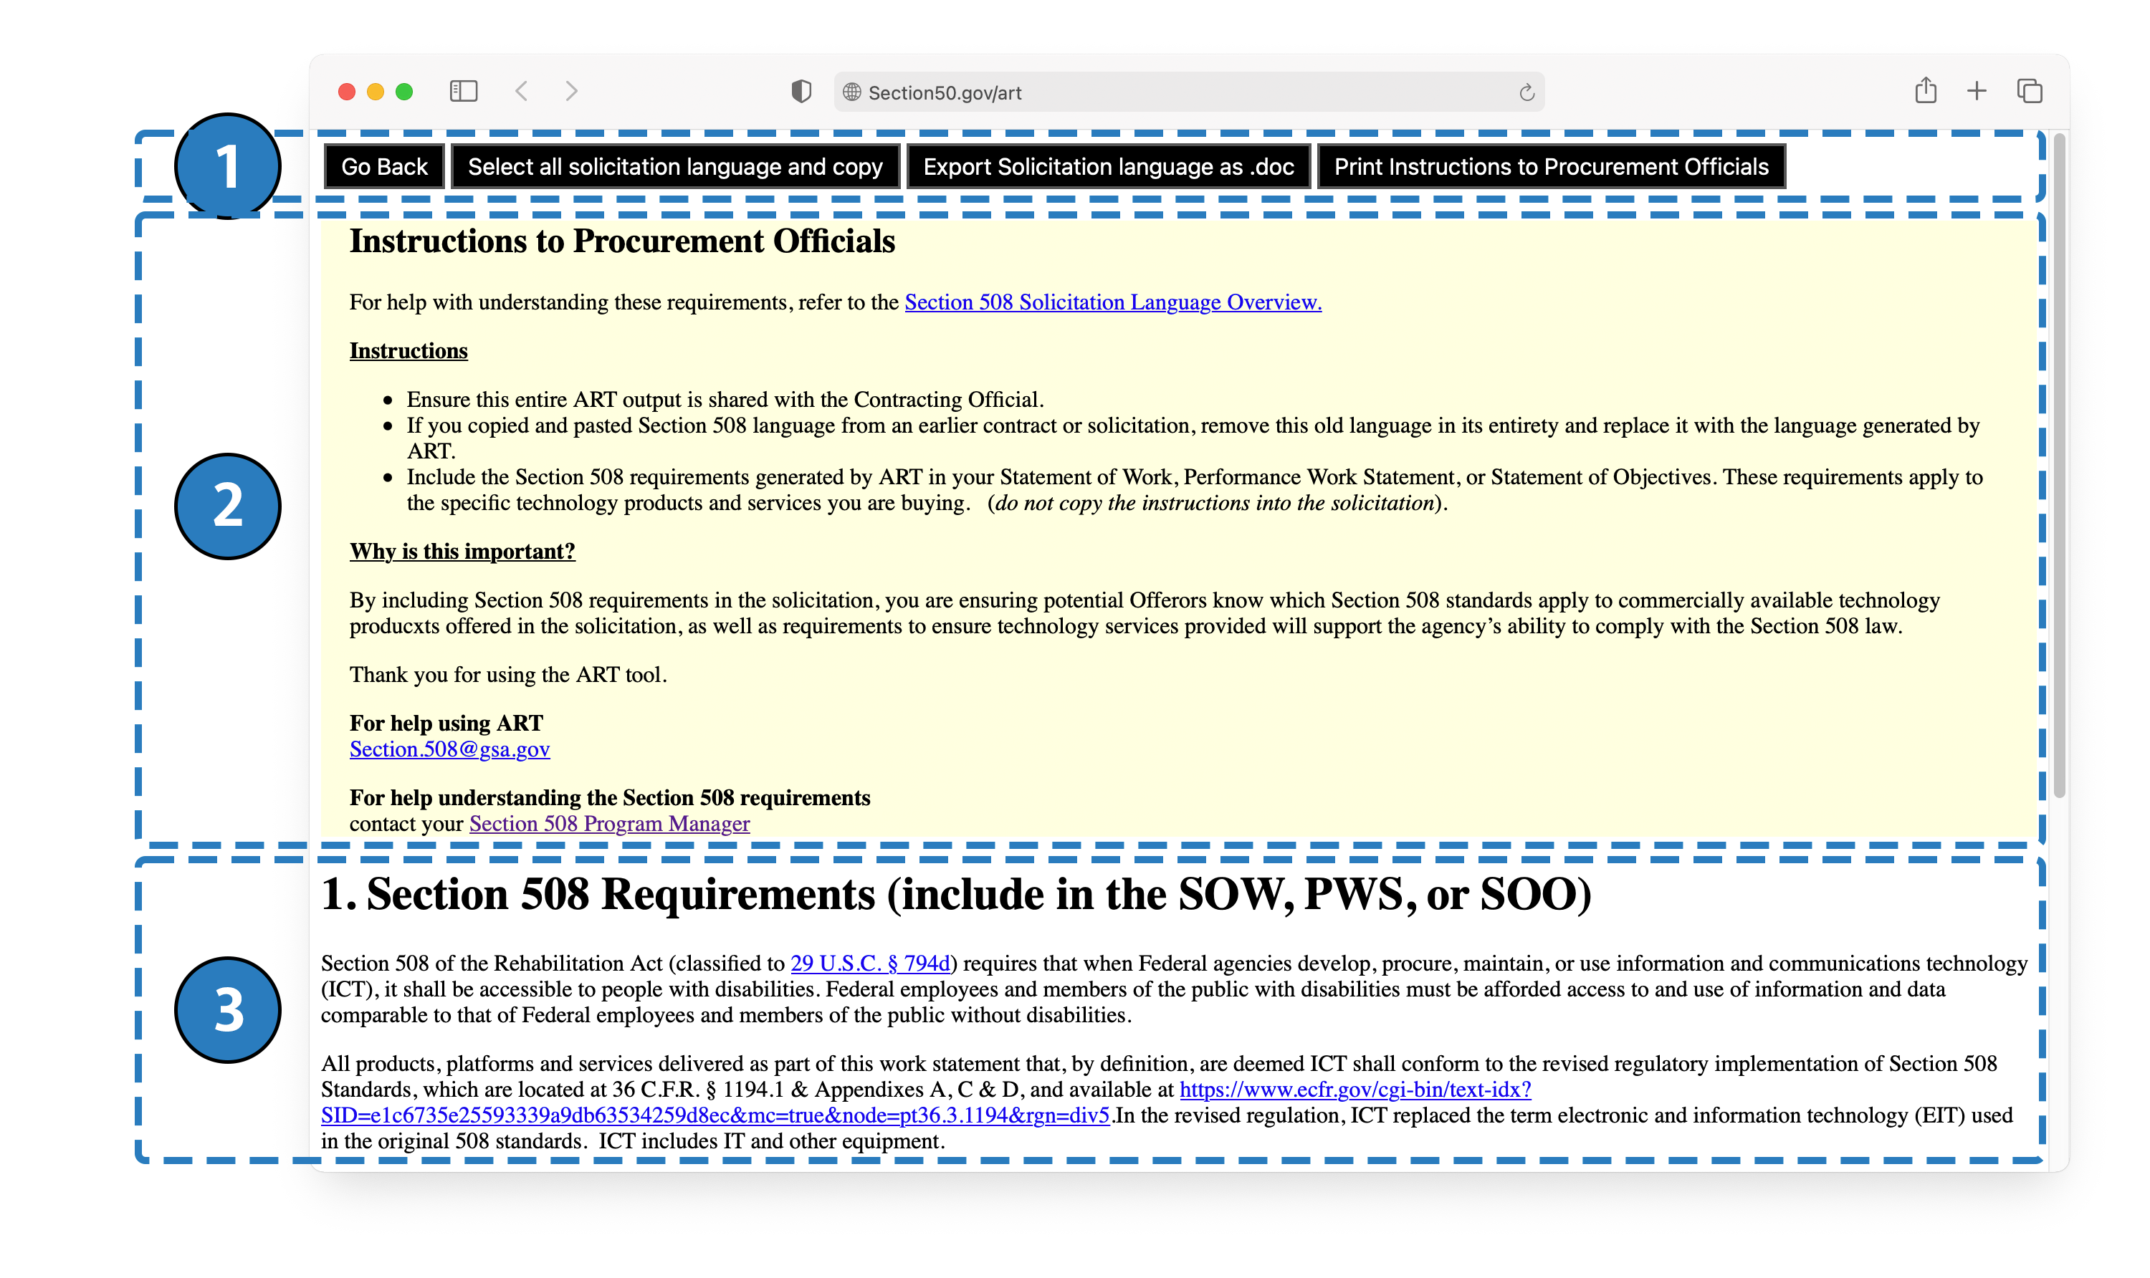
Navigating the Recommendations Page
Action Buttons
Go back to the prior screen
Select and copy all the recommended language to paste into another document (for example – a solicitation package)
Export language to Microsoft Word
Print the Instructions
Instructions – highlighted in yellow - these are for internal use only
Recommended Language

Slide 16
Getting Help
For help using ART:
Section.508@gsa.gov
For help understanding the Section 508 requirements
contact your Section 508 Program Manager

